Slide 1


Analyze Promotions and Provide Tangible Insights to the Sales Director of AtliQ’s Mart
Domain: FMCG
Function: Sales & Promotions
Created by
G Viswavardhan Reddy

Slide 2
Agenda
Project’s Objective
Data Overview
Business/Ad-Hoc Requests
Report Demonstration
Insights

Slide 3
Objective
AtliQ Mart is a retail giant with over 50 supermarkets in the southern region of India.
All of AtliQ’s stores ran a massive promotion on their products during Diwali 2023 and Sankranti 2024 (festive time in India).
Bruce Haryali, Sales Director of AtliQ, wants to understand which promotions did well and which did not so that they can make informed decisions for their next promotional period.
The company seeks insights on 5 Business requests and wants to know about store performance analysis, promotional analysis, and product and category analysis.

Slide 4
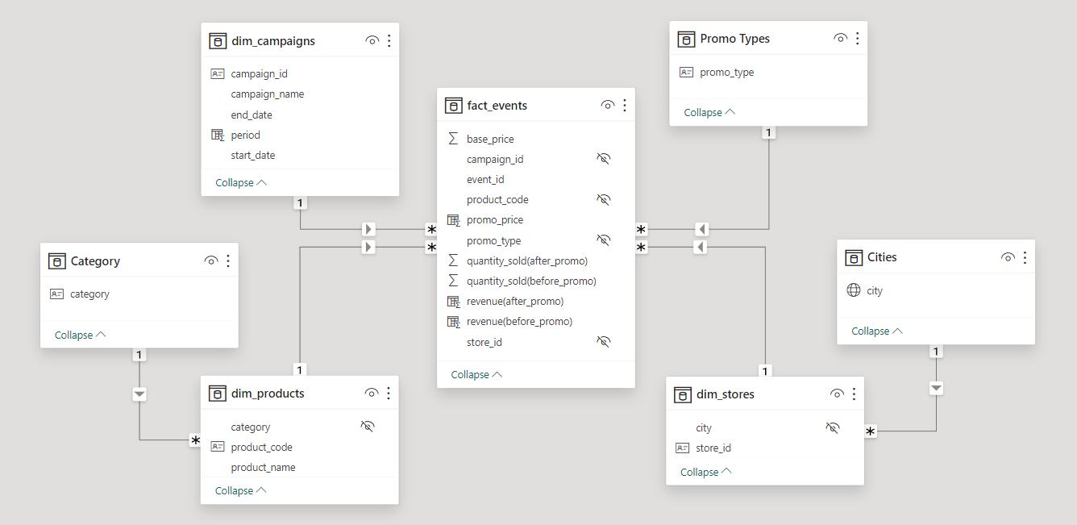
Data Overview and Model

Slide 5

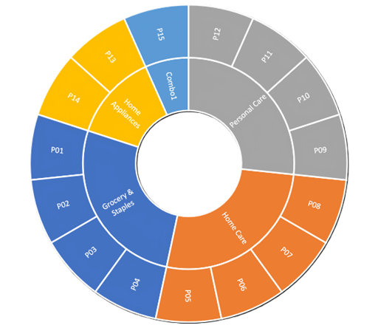
Product Hierarchy
Outer Circle
Products
Inner Circle
Category

Slide 6
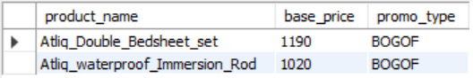
1. Provide a list of products with a base price greater than 500 and featured in the promo type of 'BOGOF' (Buy One Get One Free).
High-value products that are currently being heavily discounted.
Knowing this information helps AtliQ evaluate pricing and promotional strategies.

Slide 7

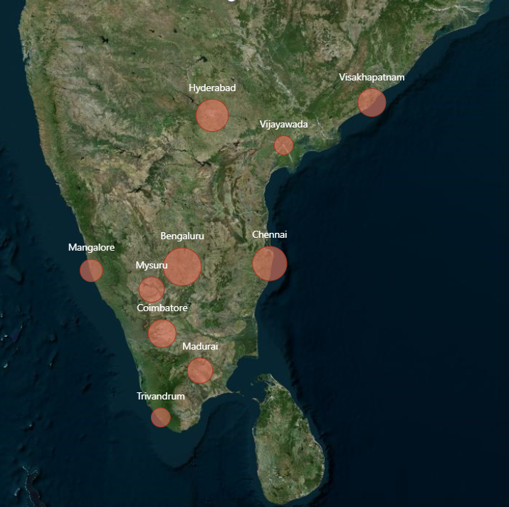
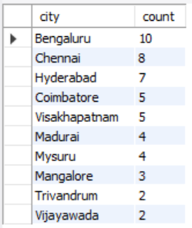
2. Generate a report that provides an overview of the number of stores in each city.
AtliQ to understand cities with the highest/lowest store presence

Slide 8
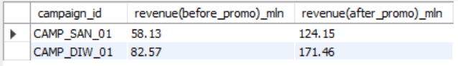
3. Generate a report that displays each campaign along with the total revenue generated before and after the campaign.
Diwali – 88.89M
Sankranti – 66.02M
Evaluate the financial impact of promotional campaigns.

Slide 9
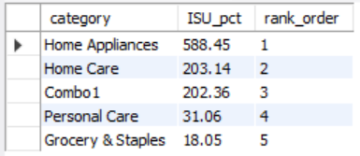
4. Produce a report that calculates the incremental sold quantity (ISU%) for each category during the Diwali campaign. Additionally, provide rankings for the categories based on their ISU%.
Assess the category-wise success and impact of the Diwali campaign on incremental sales.

Slide 10
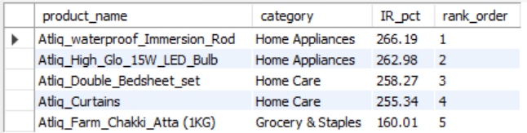
5. Create a report featuring the Top 5 products, ranked by Incremental Revenue Percentage (IR%), across all campaigns.
Identifies most successful products in terms of incremental revenue across all campaigns.

Slide 11
Incremental Revenue (IR)
Incremental revenue measures the additional revenue generated during promotions compared to non-promotional periods.
It provides a direct insight into the financial impact of promotions on overall sales.
It helps to assess the overall profitability of promotions.

Slide 12
Incremental Sold Units (ISU):
Incremental sold units measure the additional quantity of products sold during promotional periods compared to non-promotional periods.
It indicates the effectiveness of promotions in driving sales volume.
It provides insights into the promotional strategies' ability to increase market share, brand visibility, and clear excess inventory.

Slide 13
Report Demonstration

Slide 14
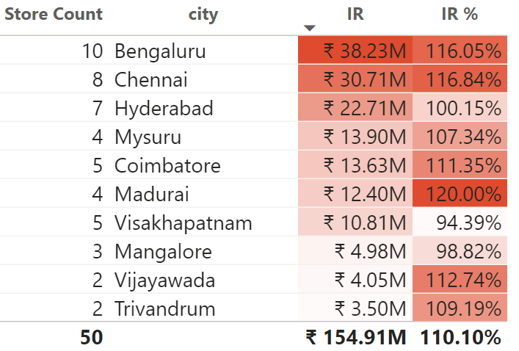
Insights
number of stores alone may not directly correlate with the incremental revenue generated
Madurai stands out with a remarkable 120% increase
local demographics
purchasing power
marketing effectiveness
consumer behavior

Slide 15
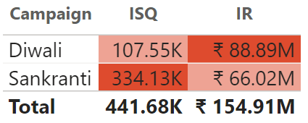
Insights
Despite selling few units, the Diwali campaign generated significantly higher revenue.
purchase of premium or high-value products
The Sankranti campaign resulted in significantly higher incremental sales compared to the Diwali campaign.
attractive promotional offers targeting a broader consumer base
more number of products bought by consumers under the categories (grocery & staples, home appliances, and home care) offers BOGOF promotion type.

Slide 16
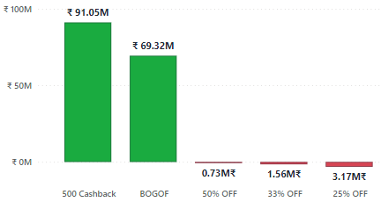
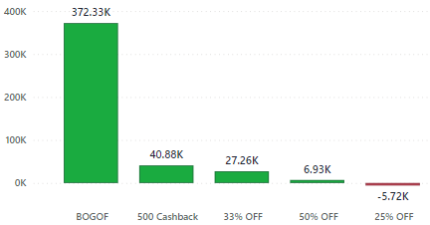
IR
ISU
All discount-based promotion types are not performing well.
25% promotion type is not performing well.
The promotion types 33% and 50% drove sales volume but resulted in a decrease in IR. This indicates that discounts severely impact the overall revenue.
The promotion type 25% might not have resonated well with consumers or failed to drive sufficient sales volume, leading to a decrease in overall IR.

Slide 17
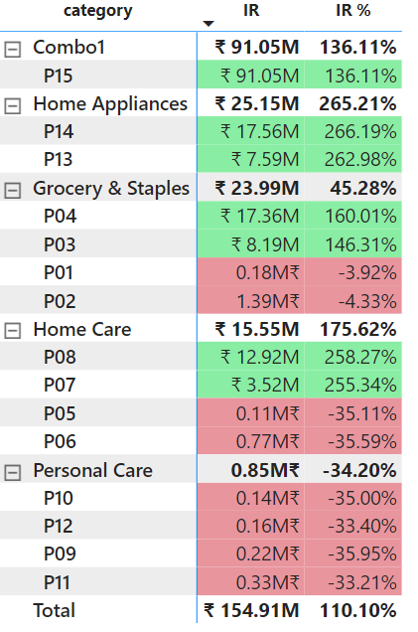
Home_Essential_8_Product_combo
WaterProof_Immersion_Rod
Body_Milk_Nourishing_Lotion (120ML)
Doodh_Kesar_Body_Lotion (200ML)

Slide 18
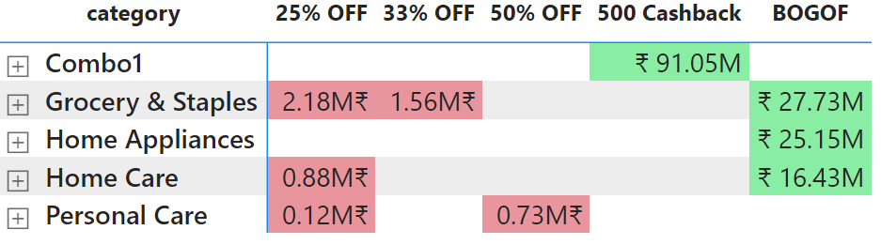
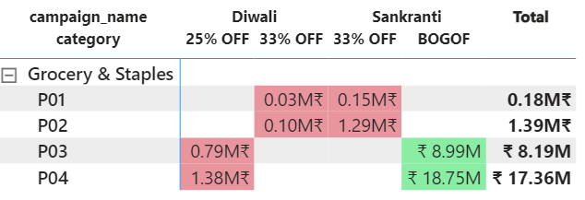
Correlation
No 2 promo types will be given for the same product/category during the same campaign

Slide 19
The City Bengaluru, with the highest number of stores 10 generates an incremental revenue of 38.23M reports first.
Top 10 stores from Mysore (2), Chennai (4), and Bengaluru (4) in terms of IR.
Bottom 10 stores from Coimbatore (1), Vijayawada (2), Mangalore (3), Trivandrum (2), and Visakhapatnam (2) in terms of ISU.
The top 2 promotion types that resulted in the highest IR are 500 cashback and BOGOF.
The bottom 2 promotion types that resulted in terms of ISU are 50% and 25%.
Of all the promotion types, discount-based are not performing well.
The promotion type 500 Cashback strikes the best balance ISU and maintains healthy margins.
The product category Combo1 with incremental revenue of 91.05M reports first.
Home_Essential_8_Product_combo and WaterProof_Immersion_Rod respond exceptionally well to the promotions.
Doodh_Kesar_Body_Lotion (200ML) and Body_Milk_Nourishing_Lotion (120ML) respond poorly to the promotions.
The product categories Grocery & Staples, Home care, and Home appliances respond well with the BOGOF promotion type.

Slide 20
Thank You

